Slide 1
Managing Change – UNHCR leadership development
Doug Reeler
Community development Resource Association, Cape Town
Notes:
This template can be used as a starter file for presenting training materials in a group setting.
Sections
Right-click on a slide to add sections. Sections can help to organize your slides or facilitate collaboration between multiple authors.
Notes
Use the Notes section for delivery notes or to provide additional details for the audience. View these notes in Presentation View during your presentation.
Keep in mind the font size (important for accessibility, visibility, videotaping, and online production)
Coordinated colors
Pay particular attention to the graphs, charts, and text boxes.
Consider that attendees will print in black and white or grayscale. Run a test print to make sure your colors work when printed in pure black and white and grayscale.
Graphics, tables, and graphs
Keep it simple: If possible, use consistent, non-distracting styles and colors.
Label all graphs and tables.

Slide 2
Objectives
Explore some key ideas and principles of change and the challenges of “managing change”
Grasp some interesting frameworks and learn some new questions
Apply what you have learnt to some of your own challenges
Learn a technique for helping people to work with change more developmentally
Notes:
Give a brief overview of the presentation. Describe the major focus of the presentation and why it is important.
Introduce each of the major topics.
To provide a road map for the audience, you can repeat this Overview slide throughout the presentation, highlighting the particular topic you will discuss next.

Slide 3
“Better question… next steps” technique
Notes:
This is another option for an Overview slides using transitions.

Slide 4
Procedure
Write down three important “managing change challenges” that you are facing.
Choose one of them and turn it into a question.
Think of an experience you have had (or are having) that gave rise to this. Make notes.
Share your question and experience with a neighbour. Assist each other to reflect on the question and experience and then to improve or find a better question.
Then decide what you are going to do next, towards answering the question.
Notes:
Give a brief overview of the presentation. Describe the major focus of the presentation and why it is important.
Introduce each of the major topics.
To provide a road map for the audience, you can repeat this Overview slide throughout the presentation, highlighting the particular topic you will discuss next.

Slide 5
“People don’t resist change. They resist being changed”.
In my experience…

Slide 6
Key ideas and Principles
(or simple truths we often forget)

Slide 7
Change is a process not an event. Why is this obvious insight important?
Change is often a complex and paradoxical process, largely invisible to perception and understanding, until after the fact (maybe).
People are diverse. In what ways? What implications for change?
“People don’t resist change. They resist being changed” (Peter Senge)
Notes:
Give a brief overview of the presentation. Describe the major focus of the presentation and why it is important.
Introduce each of the major topics.
To provide a road map for the audience, you can repeat this Overview slide throughout the presentation, highlighting the particular topic you will discuss next.

Slide 8
There is an increasing disjuncture between increasingly post-modern, fast changing, freedom-wanting, co-creative individuals and archaic, slow-changing controlling institutions, organisations and systems. How do we deal with this gap? How do we herd cats?
Change comes in many diverse forms and processes – observe and understand the underlying change conditions and change potential before considering appropriate interventions
Notes:
Give a brief overview of the presentation. Describe the major focus of the presentation and why it is important.
Introduce each of the major topics.
To provide a road map for the audience, you can repeat this Overview slide throughout the presentation, highlighting the particular topic you will discuss next.

Slide 9
Good ideas and good feelings are seldom not enough. Change often requires the will to be freed. Resistance to lives most strongly in fear, (self-) doubt and (self-) hatred. Examples?
Sometimes there is nothing you can do, but wait until the time is ripe.
Notes:
Give a brief overview of the presentation. Describe the major focus of the presentation and why it is important.
Introduce each of the major topics.
To provide a road map for the audience, you can repeat this Overview slide throughout the presentation, highlighting the particular topic you will discuss next.

Slide 10
Frameworks of change…
Notes:
Use a section header for each of the topics, so there is a clear transition to the audience.

Slide 11
Three types of change (conditions)
Projectable change
where the conditions are sufficiently healthy, predictable and fertile for working with strong visions and plans
Emergent Change
How people learn their way into the future – where things are unpredictable or uncertain and the best process is to learn your way there (Kolb’s learning cycle)
Notes:
This is another option for an Overview slide.

Slide 12
Emergent Change
Learning by doing
Trial and error
Simple learning cycle
Deep learning cycle
Notes:
This is another option for an Overview slide.

Slide 13
Three types of change (conditions)
Transformative change
where there is hot crisis or cold stuckness
To get beyond these requires unlearning and dealing with resistance to change – especially working with fear, (self-) doubt and (self-) hatred or resentment.
Notes:
This is another option for an Overview slide.

Slide 14
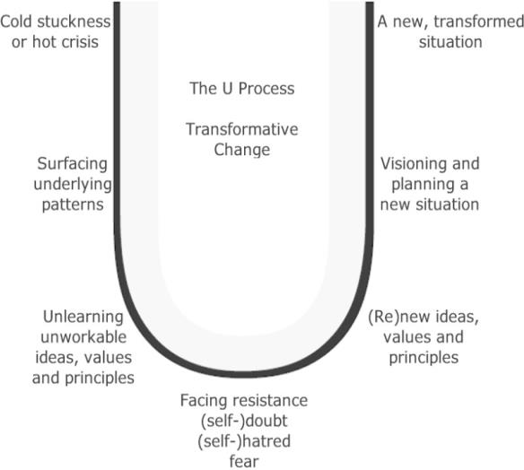
Transformative change
Notes:
This is another option for an Overview slide.

Slide 15
Nudge Theory – James Wilk
Cause and Effect
Vs
Flux and Constraint
Notes:
This is another option for an Overview slide.

Slide 16
Five change strategies
Top-down
Bottom-up
Sideways
Inside-out
Wait and see
Notes:
This is another option for an Overview slide.

Slide 17
Applying these ideas…
Notes:
Use a section header for each of the topics, so there is a clear transition to the audience.

Slide 18
Free writing prompts:
When I am trying to lead a new change I tend to…
Identify the person/people you are struggling with the most, around a change issue. The kind of change they are going through is…
My approach to them tends to be… but it could be…
Notes:
Summarize presentation content by restating the important points from the lessons.
What do you want the audience to remember when they leave your presentation?
Save your presentation to a video for easy distribution (To create a video, click the File tab, and then click Share. Under File Types, click Create a Video.)

Slide 19
Group work
Turn to your group and share some of your most interesting insights.
Open discussion
Notes:
Summarize presentation content by restating the important points from the lessons.
What do you want the audience to remember when they leave your presentation?
Save your presentation to a video for easy distribution (To create a video, click the File tab, and then click Share. Under File Types, click Create a Video.)

Slide 20
Resources
<CDRA site> <www.cdra.org.za>
<Barefoot Guide Connection> <www.barefootguide.org>

